Slide 1
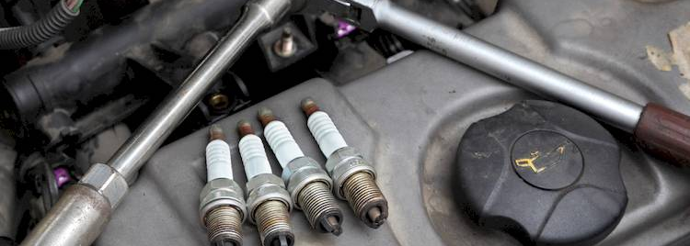
Spark Fails To Spark
Common Anti-Patterns and How to Avoid Them
Yousry Mohamed – Aug 2023

Slide 2
This session will help you if you …
Face productivity or performance issues with Spark
Want to improve your existing Spark apps
Learn more about big data and distributed computing
Learn a few extra buzzwords 😁

Slide 3

Agenda
Spark Anatomy
01
Query Patterns
02
Miscellaneous
03
Notes:
Understand your tool (how the driver and executors work)
Understand how different types of queries run
Other common use cases you see with Spark

Slide 4

Notes:
Spark can be used for EDA, data pipelines, ML, distribution of tasks like compressing images.
Spark can be used locally, on Databricks, on major cloud providers, etc.
We can quiz the magic numbers of 200 and 10MB

Slide 5
1. Spark Anatomy
Role of the driver and executors
Lazy execution
DAG and implications of task replay
How input data is initially distributed among executors

Slide 6
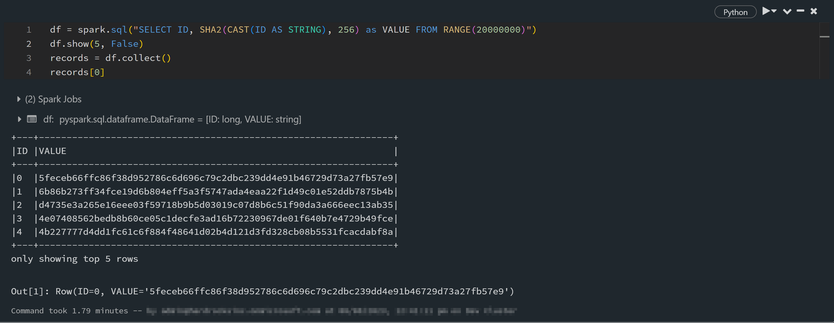
Never collect big data
Notes:
Classic df.collect
Or broadcast hashjoin big tables
Never broadcast a table bigger than 1GB because broadcast happens via the driver and a 1GB+ table will either cause OOM on the driver or make the drive unresponsive due to large GC pauses
spark.driver.maxResultSize

Slide 7
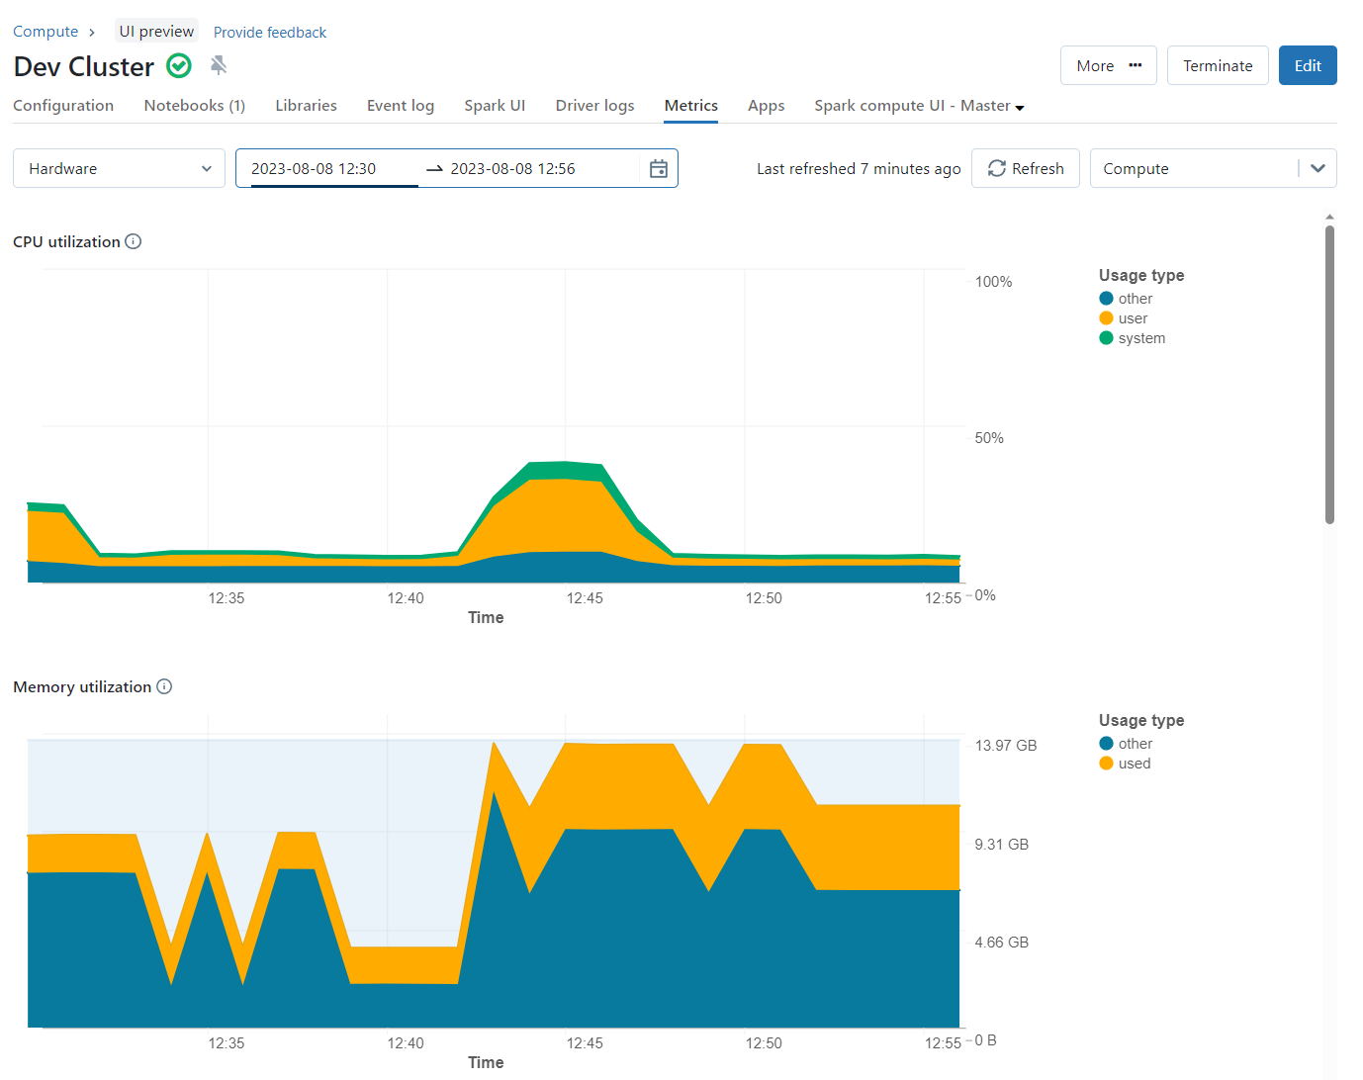

Slide 8
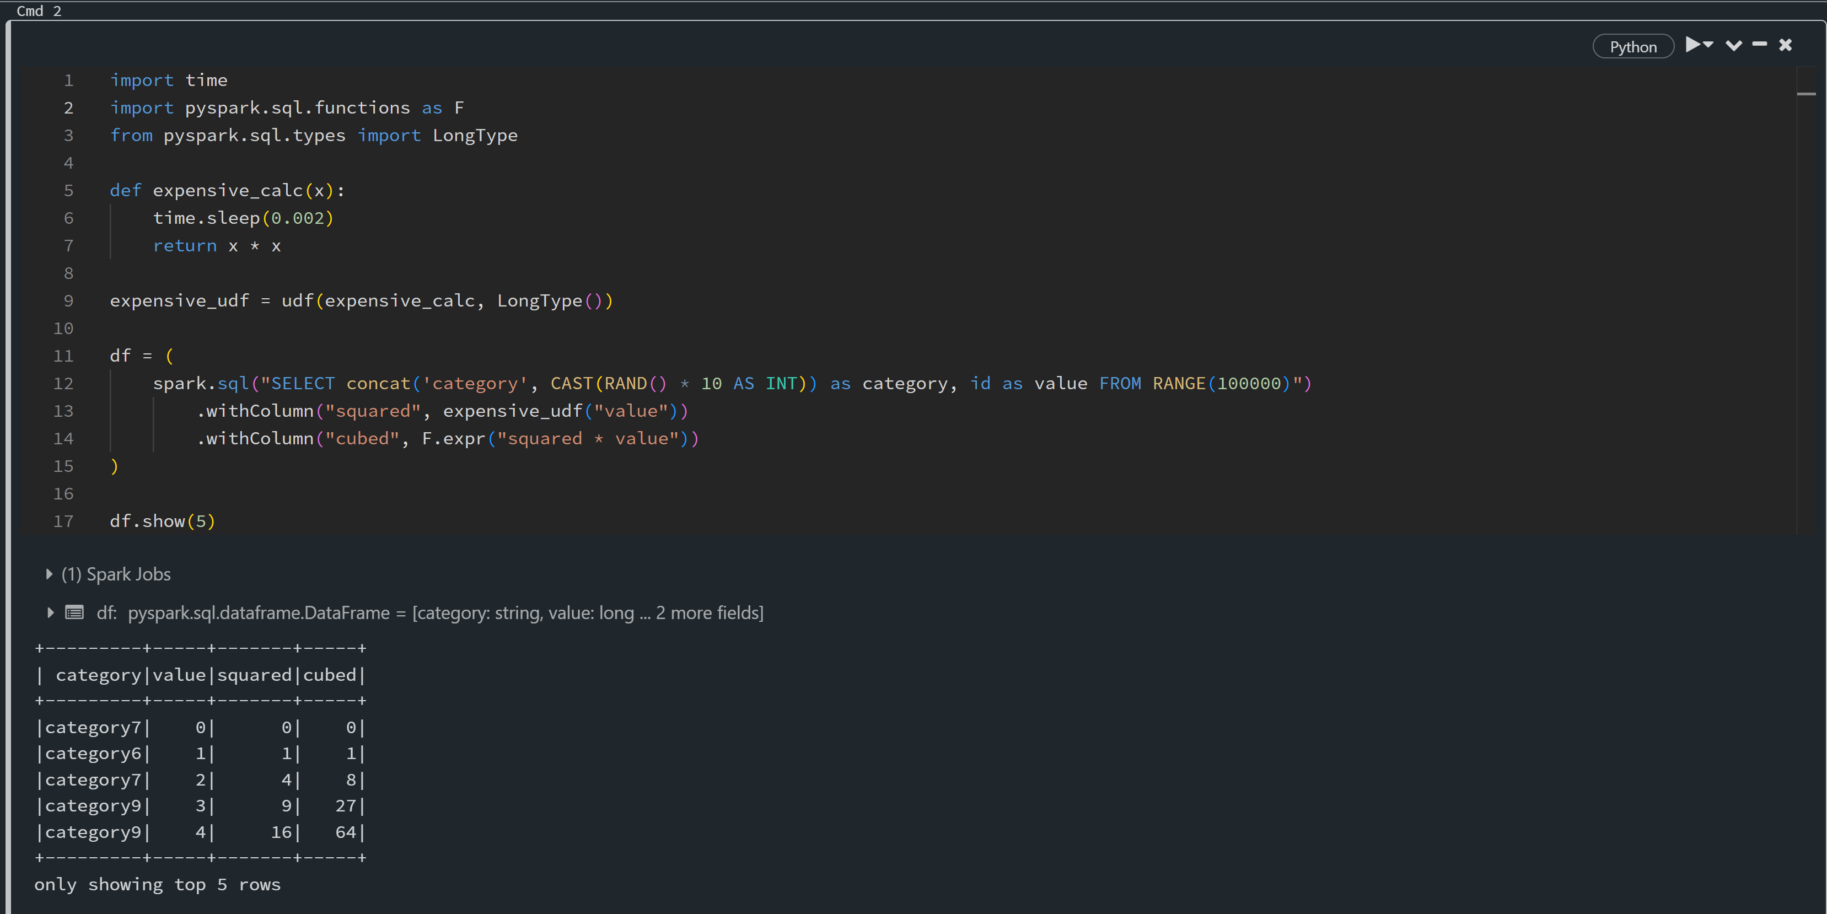
Be aware of lazy execution
Notes:
Data scientists repeating calls on an expensive dataframe
Counting records while source data has changed

Slide 9
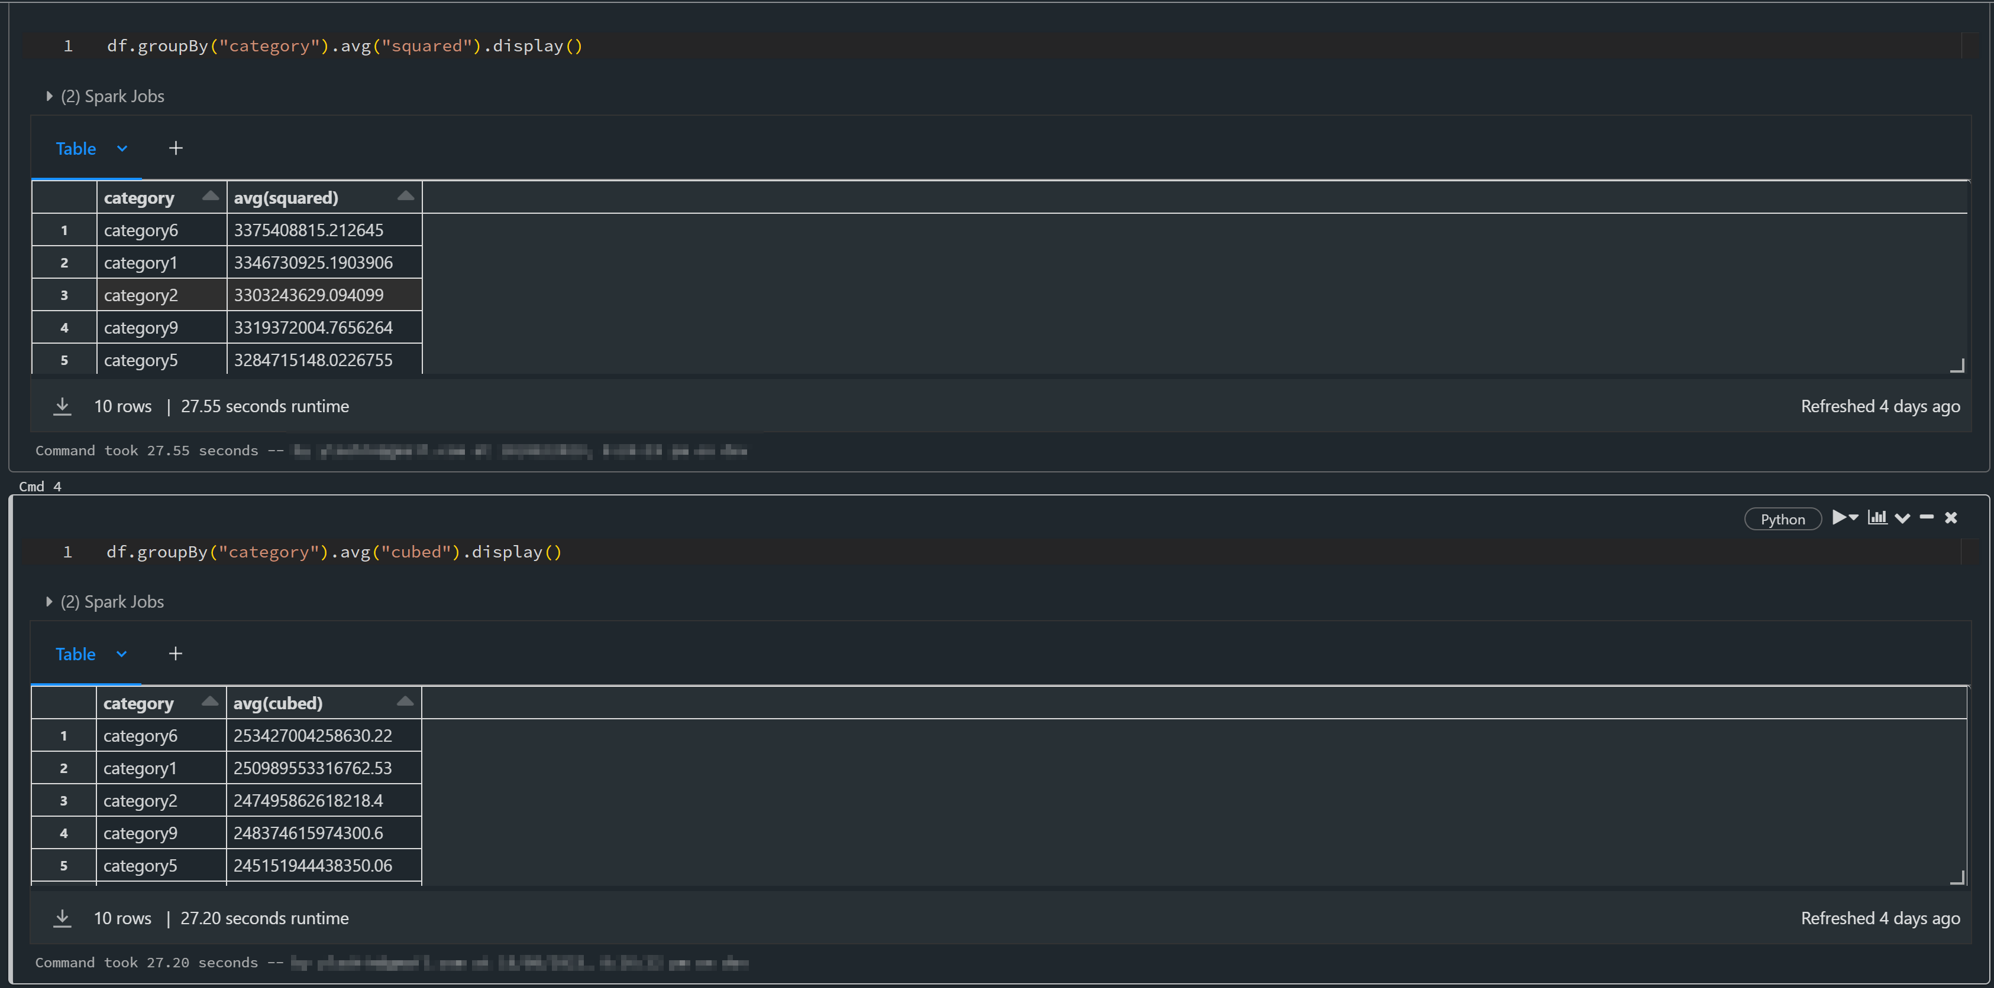
Be aware of lazy execution

Slide 10
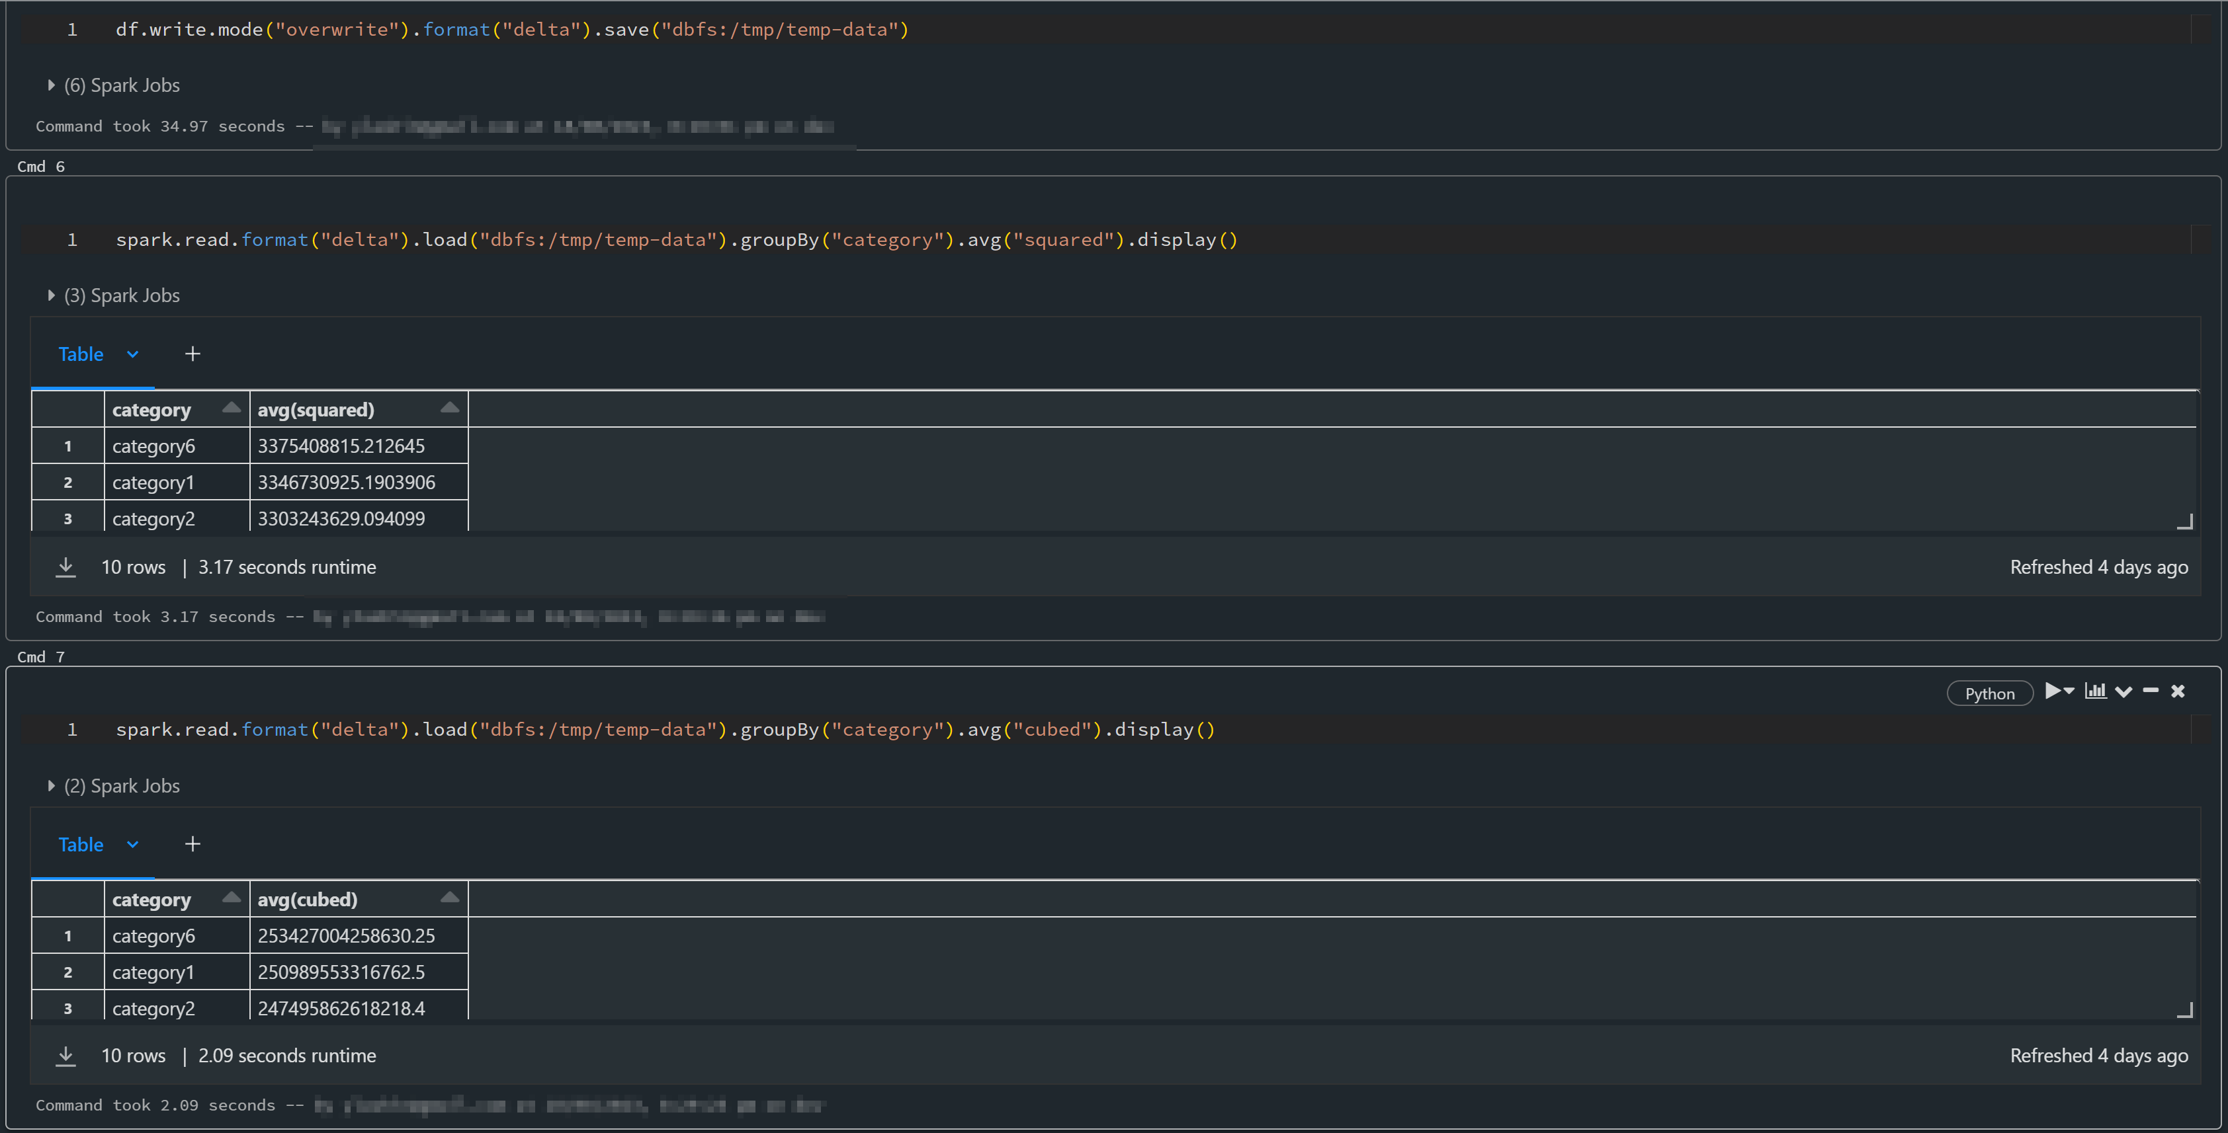
Be aware of lazy execution

Slide 11
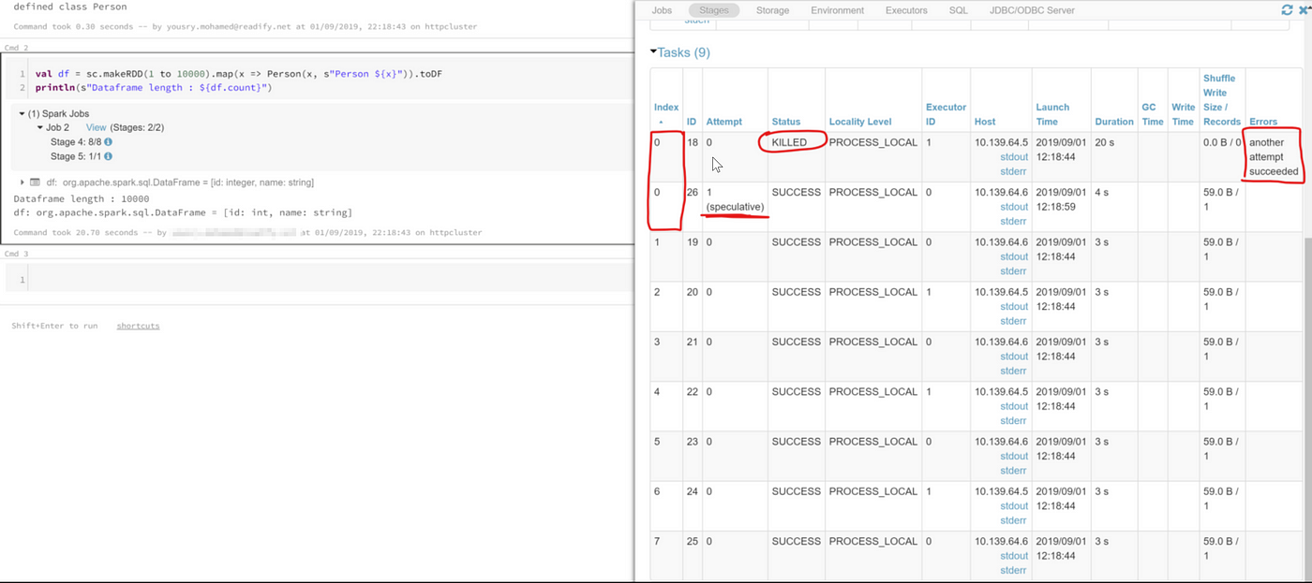
Task retry and idempotency
Notes:
Either use an idempotent sync
Or use a library that handles it for you
Or disable ask failure retry (bad idea)

Slide 12
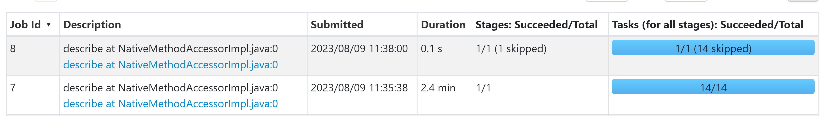
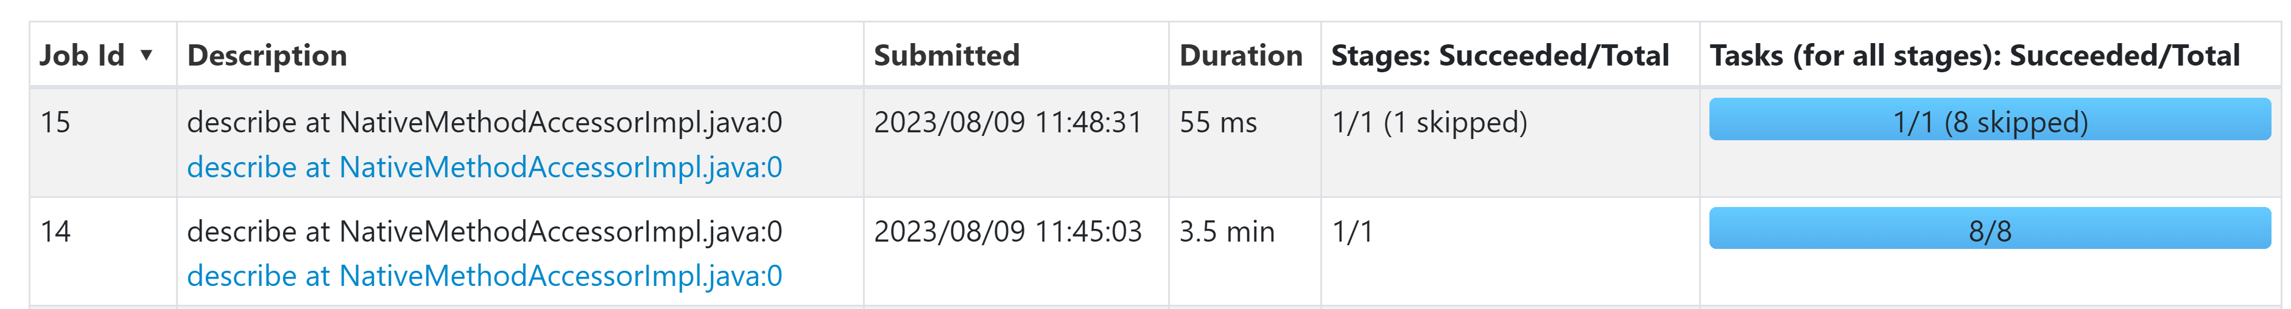
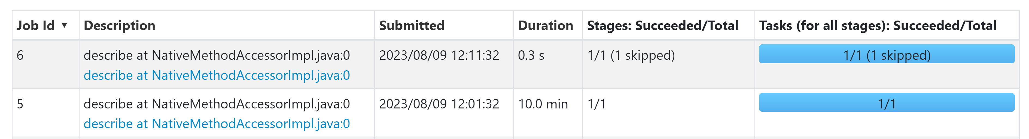
CSV file
Parquet file
GZip file

Slide 13
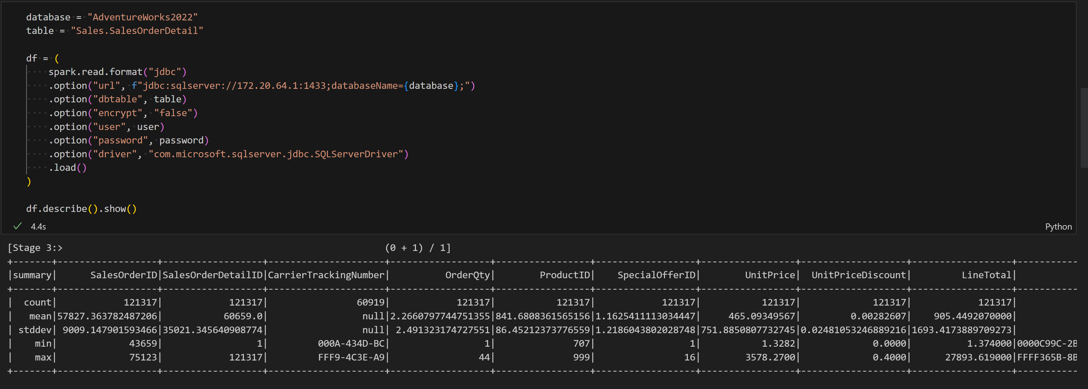
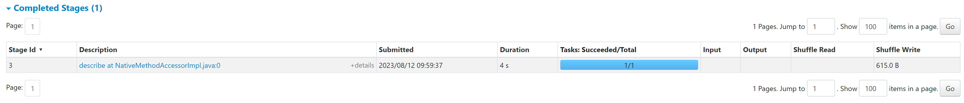
JDBC Reader

Slide 14
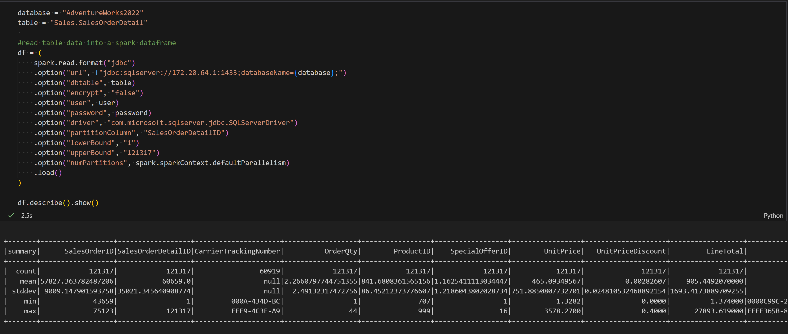
JDBC Reader with partitioned read

Slide 15
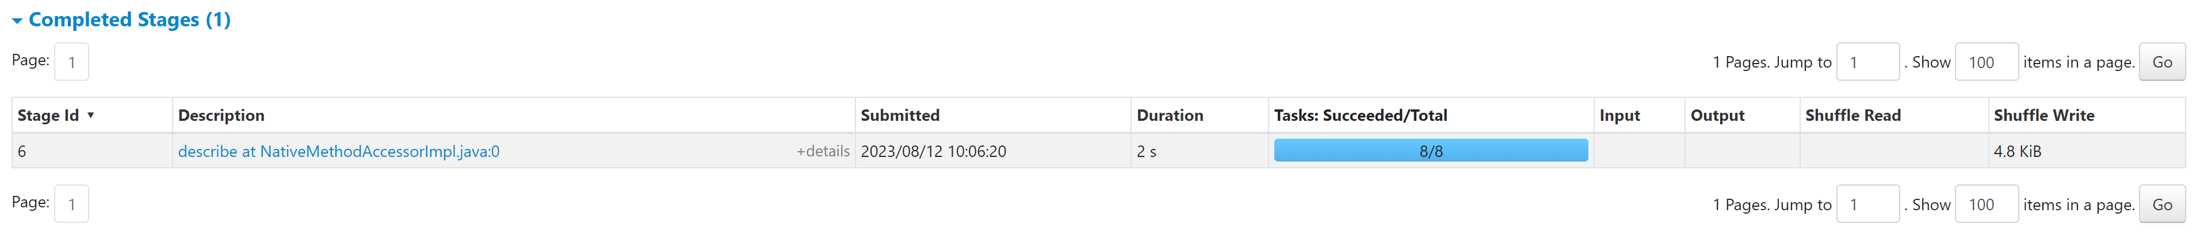
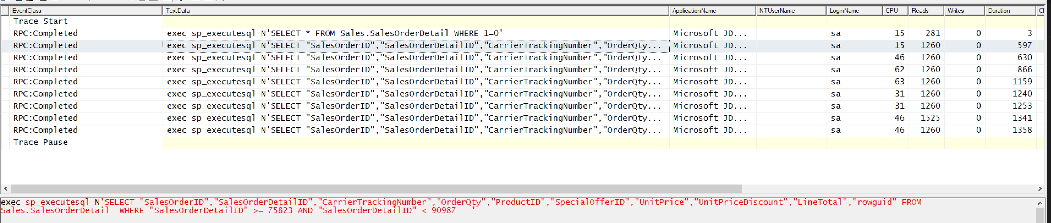
JDBC Reader with portioned read

Slide 16
2. Query Patterns
Single core queries
Data type impact
Metadata and statistics

Slide 17
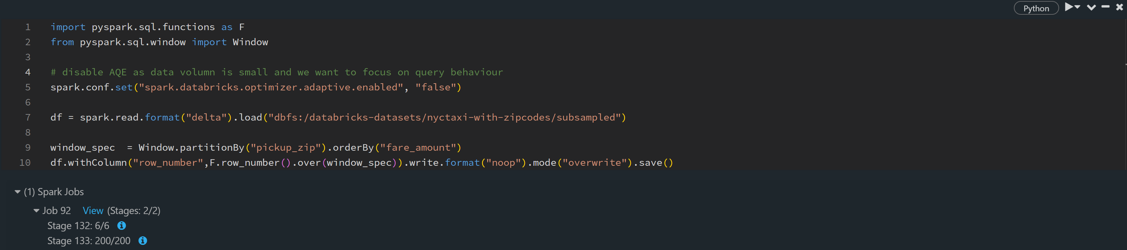
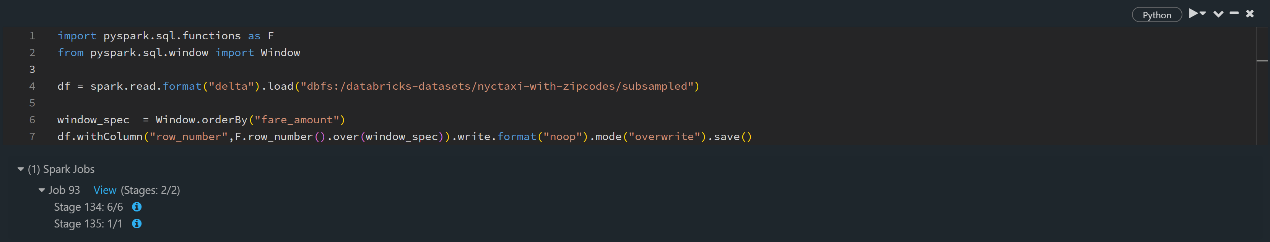
Single Core Queries
Notes:
Similar patterns can be due to data skew
Window functions without partition
Empty group by
Join with key having single value
JDBC read without query partitions

Slide 18
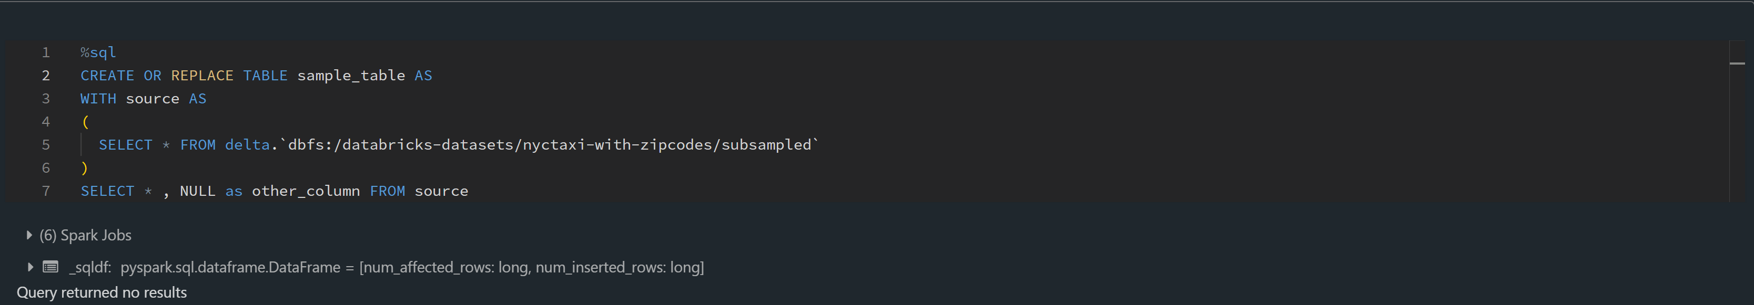
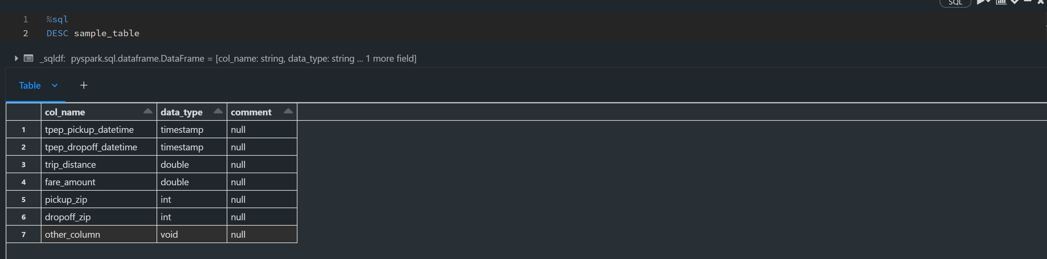
Data Types Void column as an example

Slide 19
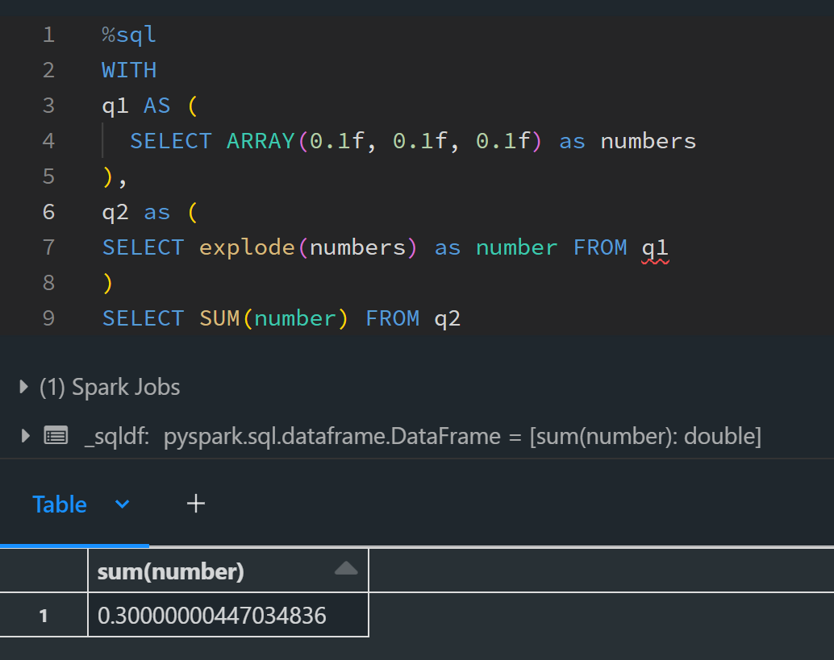
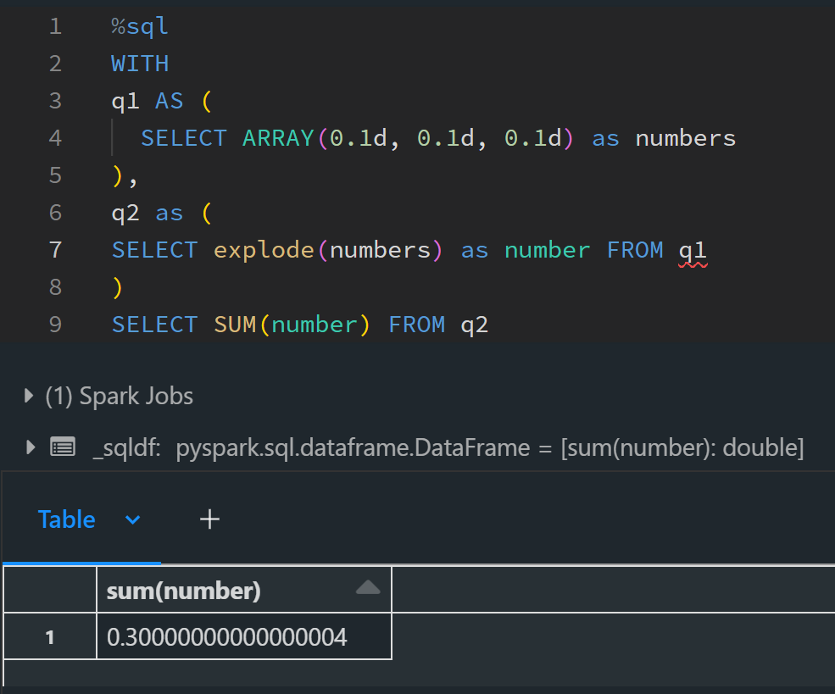
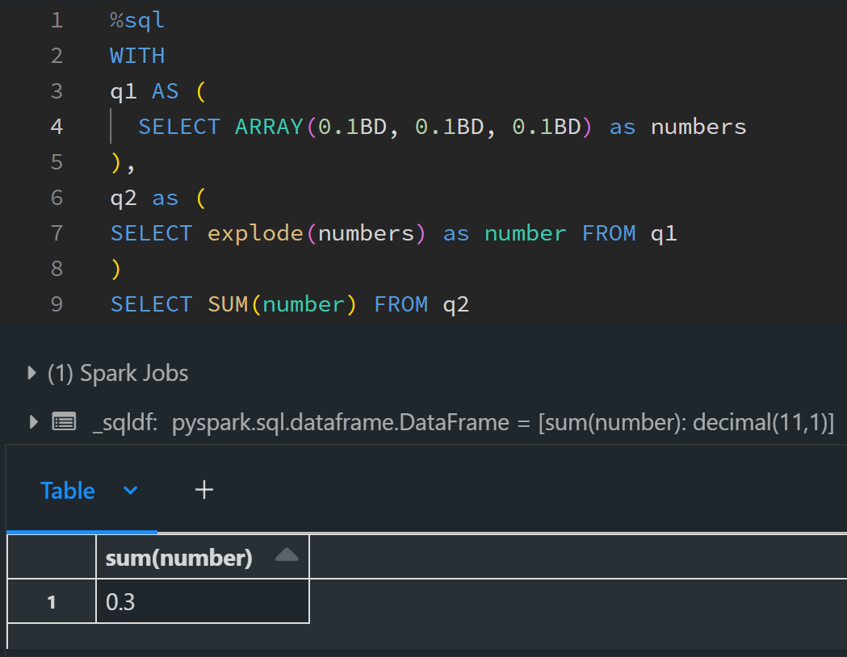
Data Types Floating Point Errors & Financial Accuracy
Notes:
Join columns with wrong types or merging to table with nonmatching column types

Slide 20
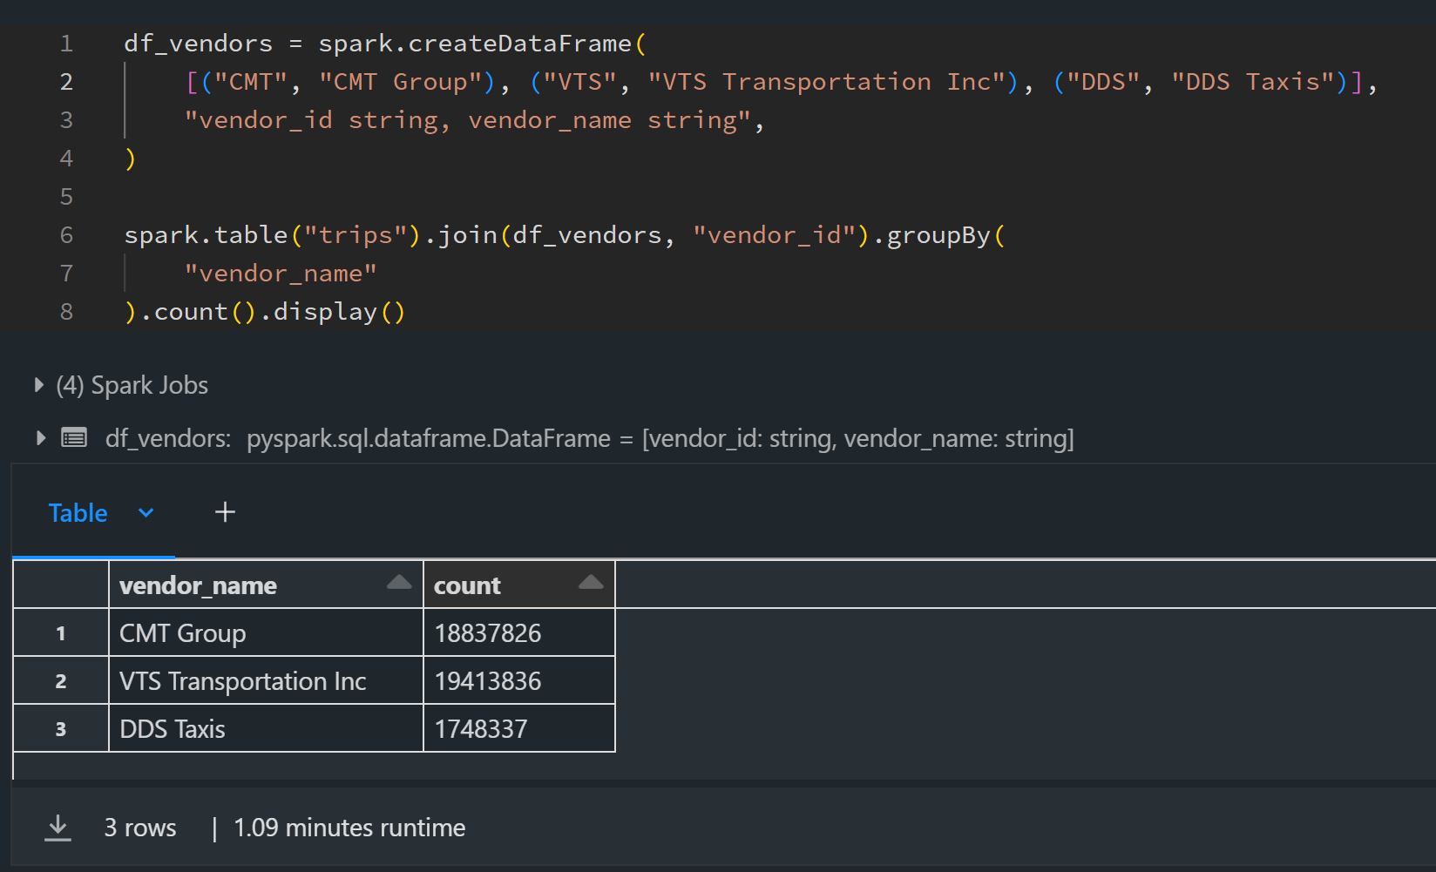
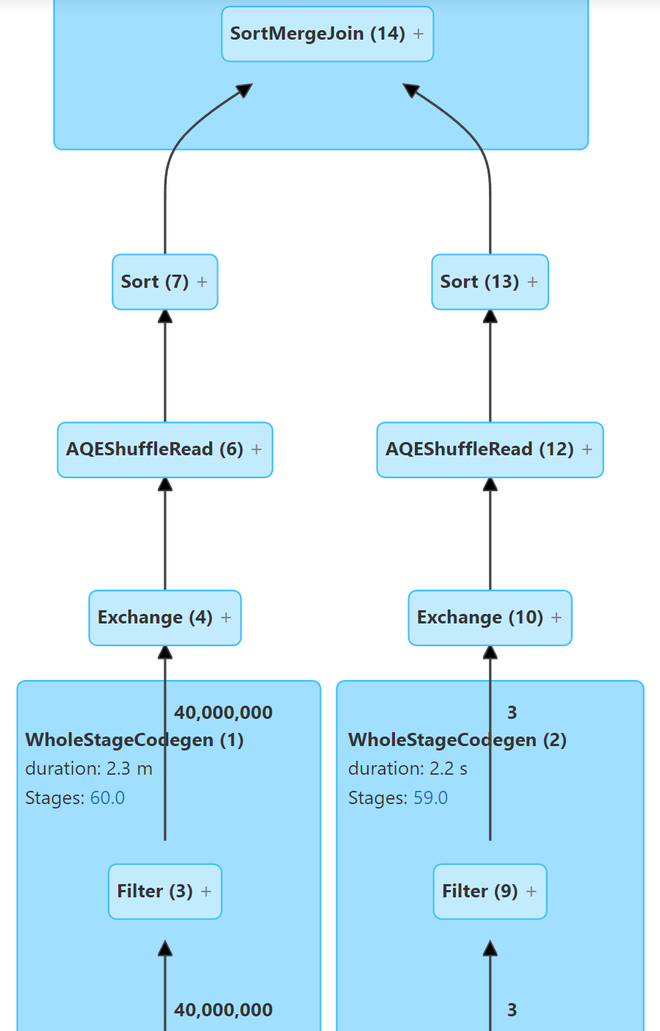
Metadata Matters
Notes:
Sometimes it can be also table/column stats

Slide 21
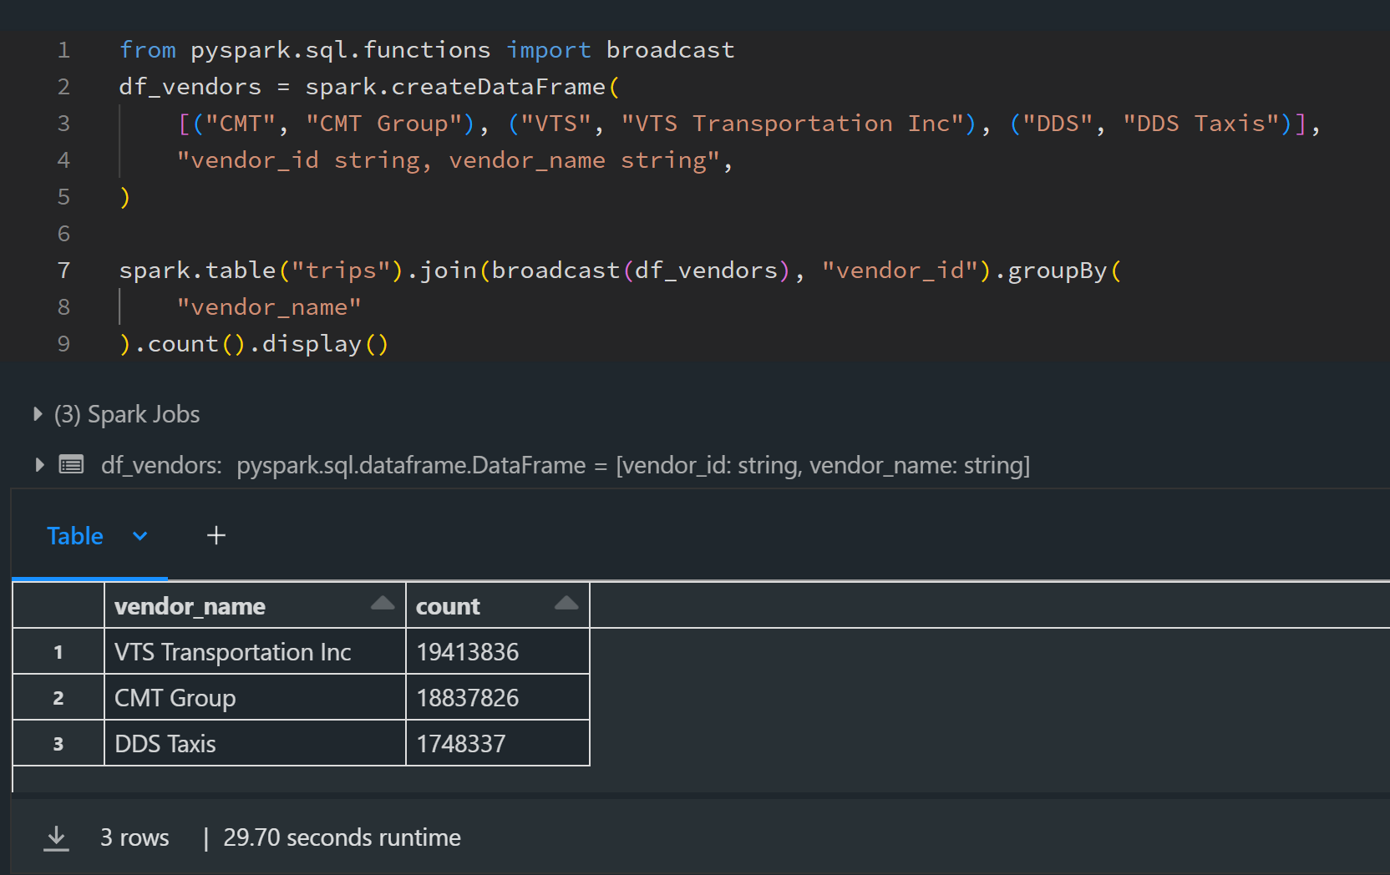
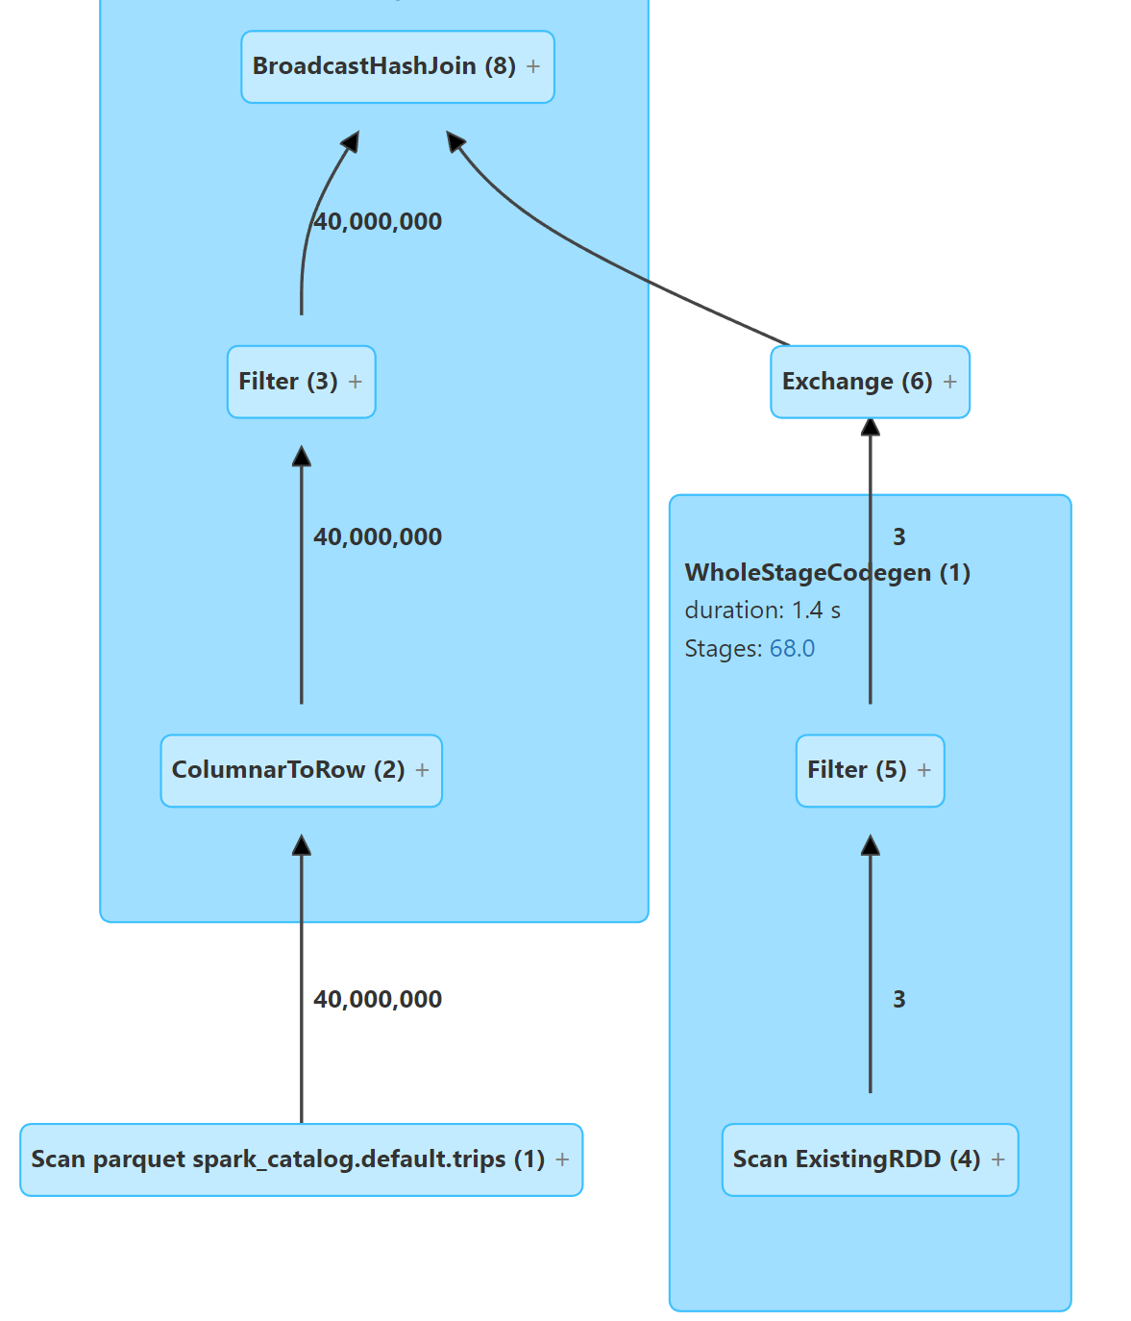
Metadata Matters

Slide 22
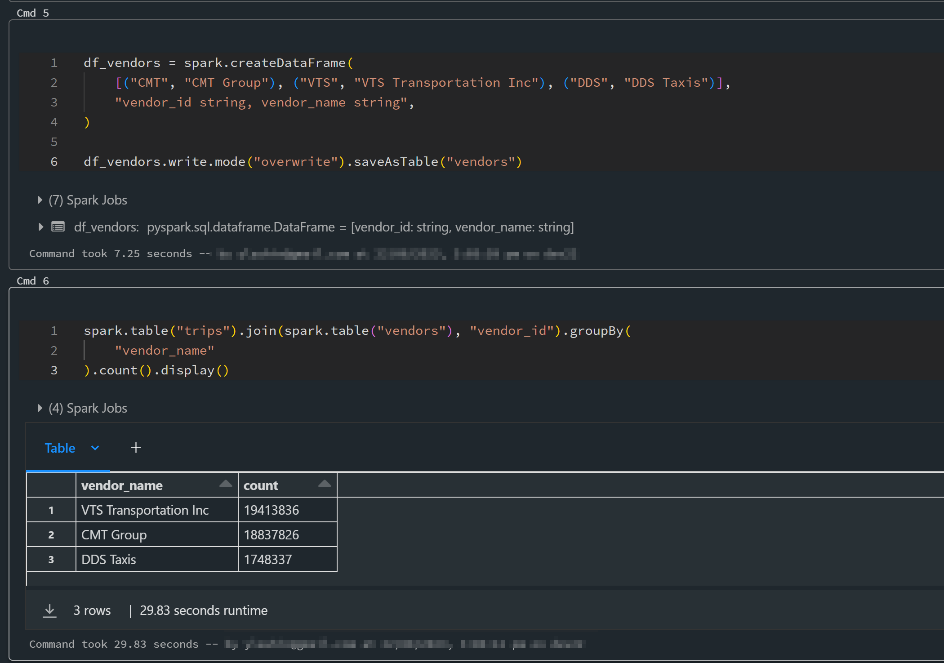
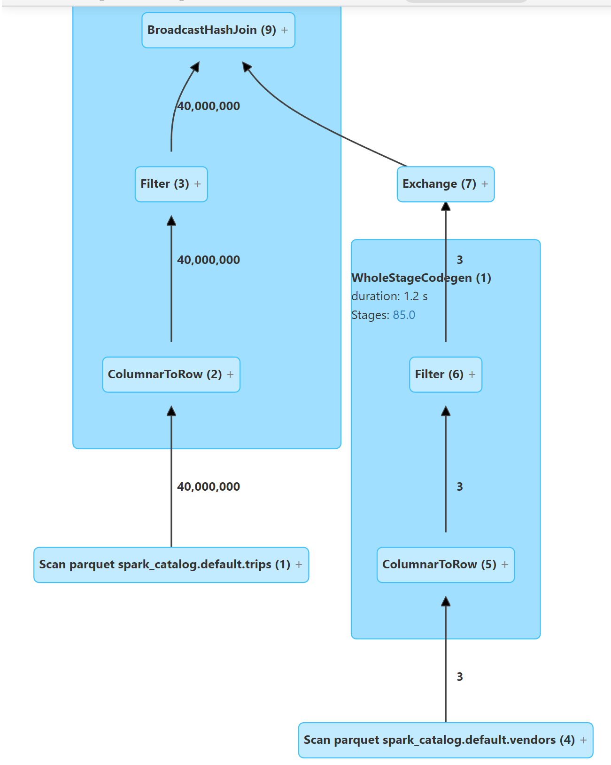
Metadata Matters

Slide 23
3. Miscellaneous
Predicate pushdown
Python UDF performance
Pandas UDFs
Spark sessions with different configs

Slide 24
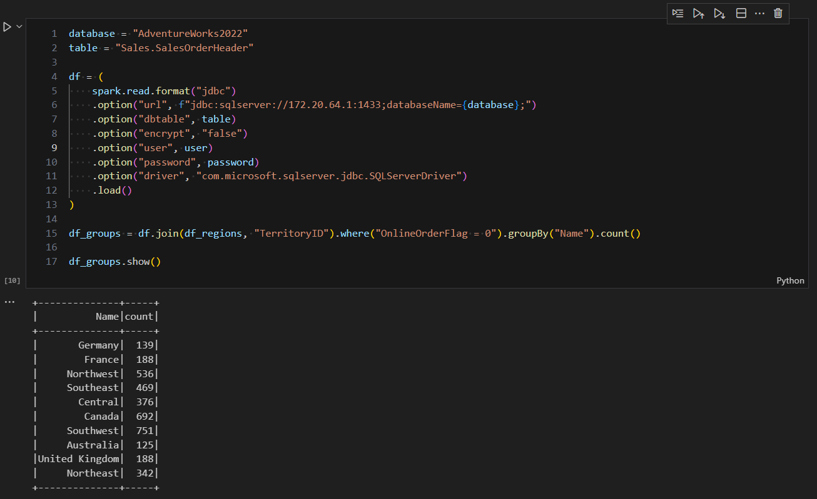
Predicate pushdown

Slide 25
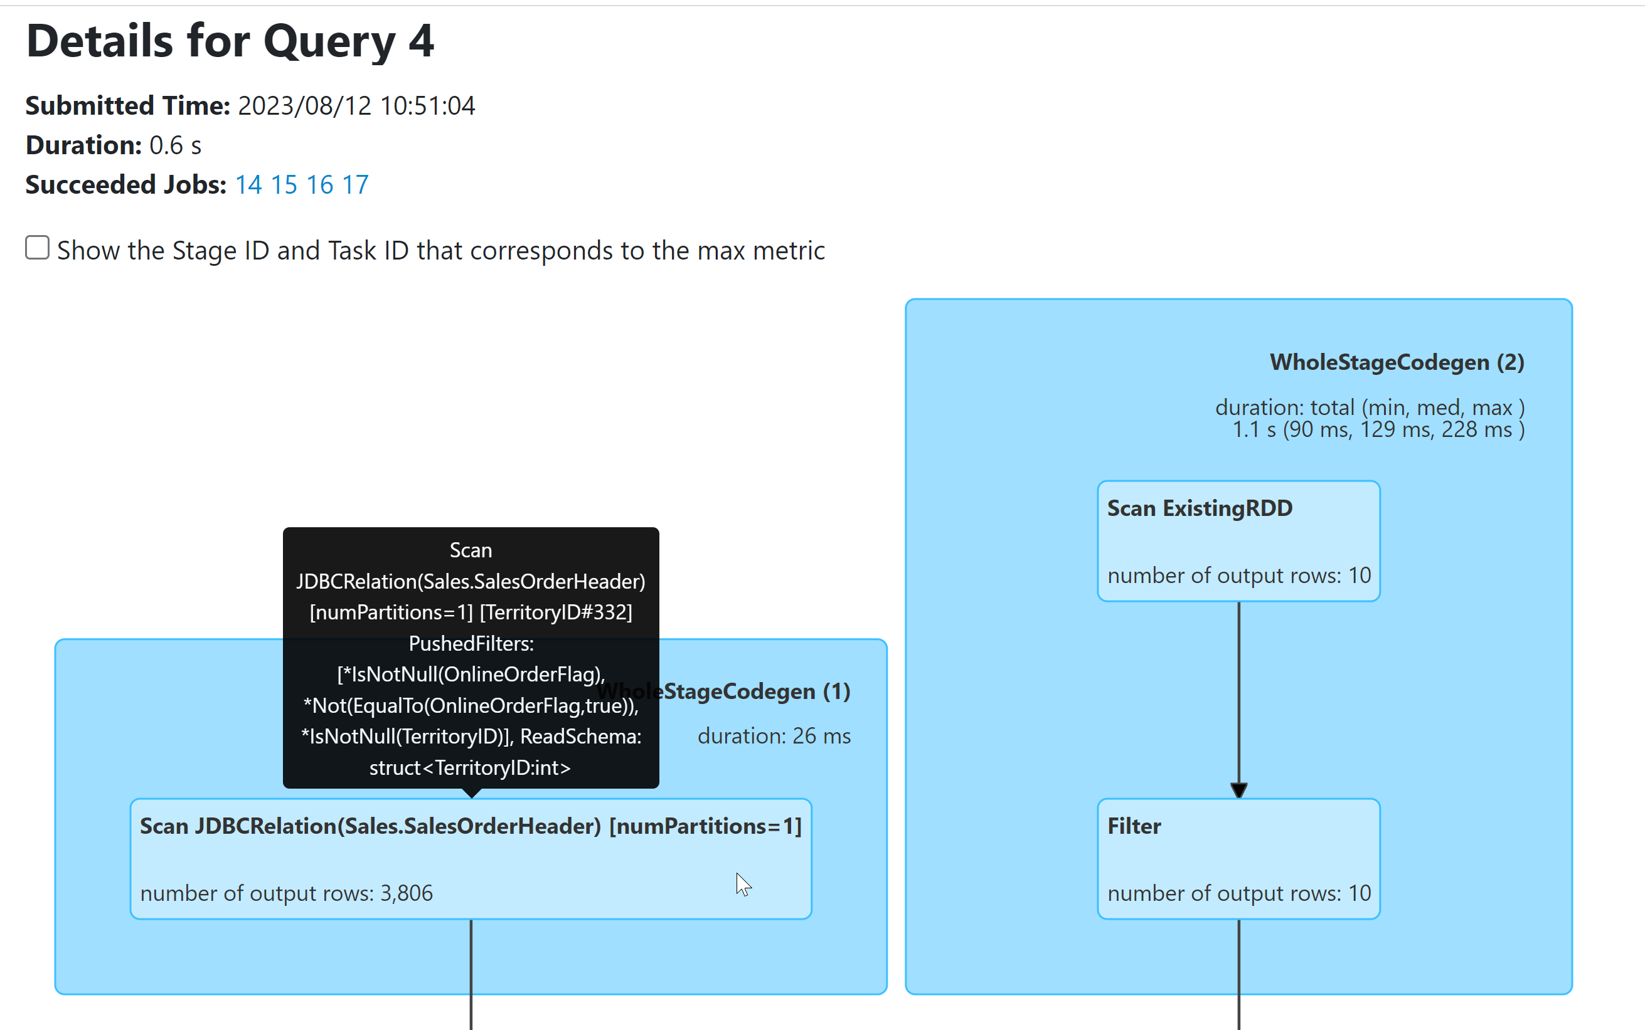
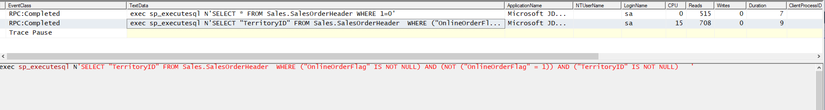
Predicate pushdown

Slide 26
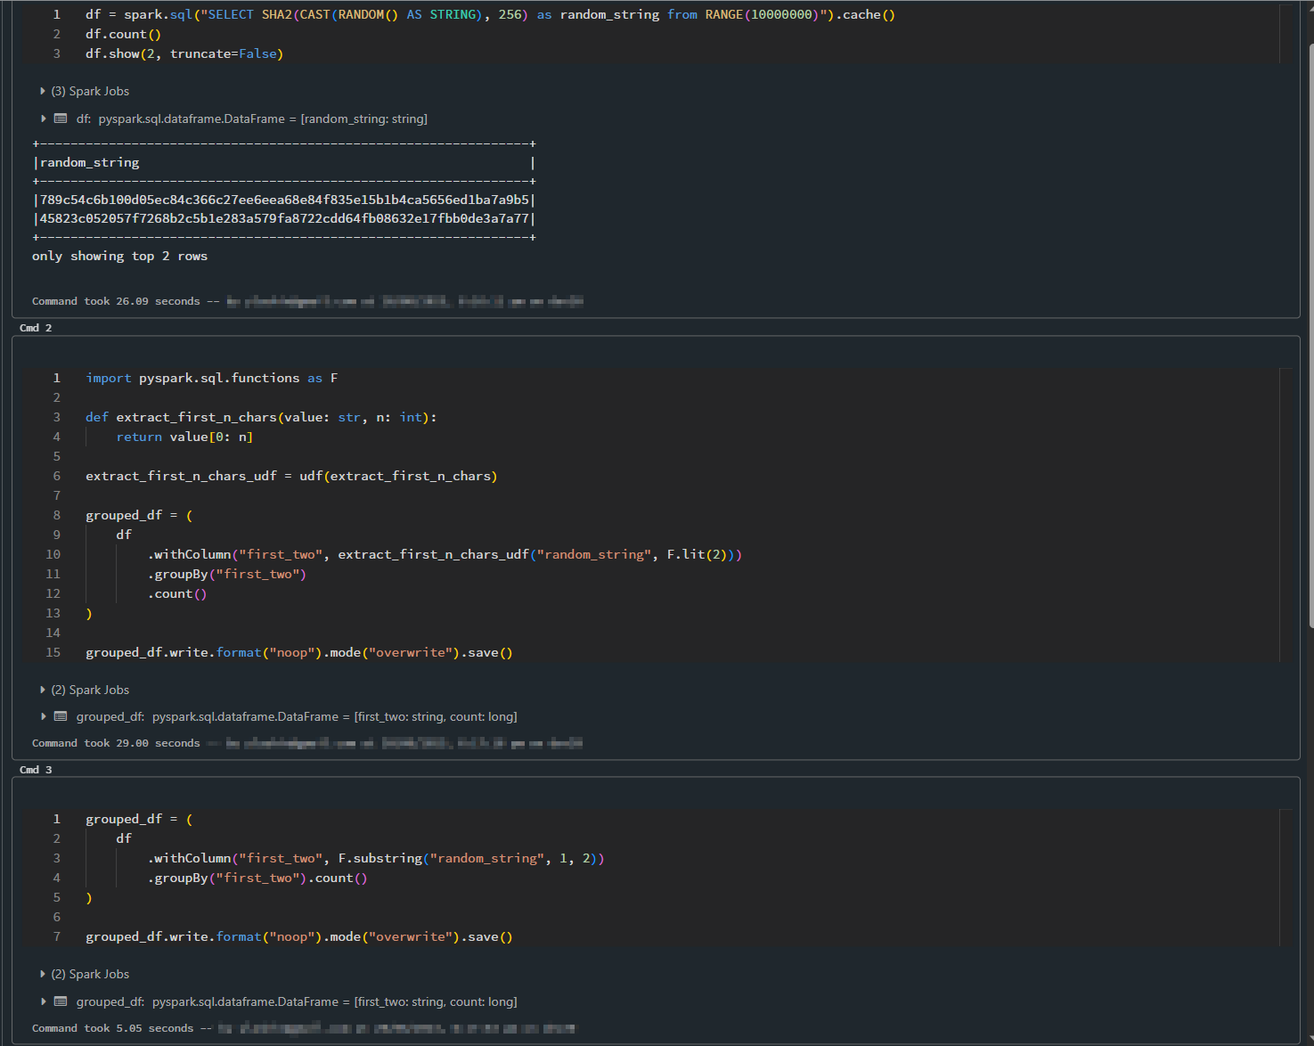
Don’t use Python UDFs – if you can
Notes:
Python UDFs are bad – in most cases you can use built-in Spark SQL functions

Slide 27
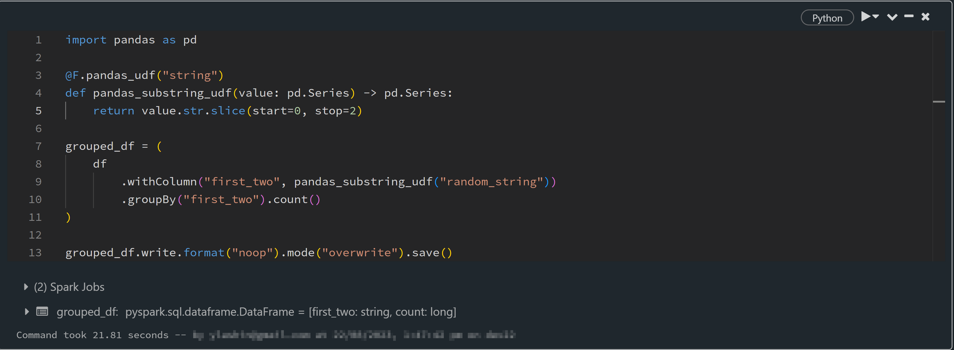
Worst case – Use Pandas UDFs

Slide 28
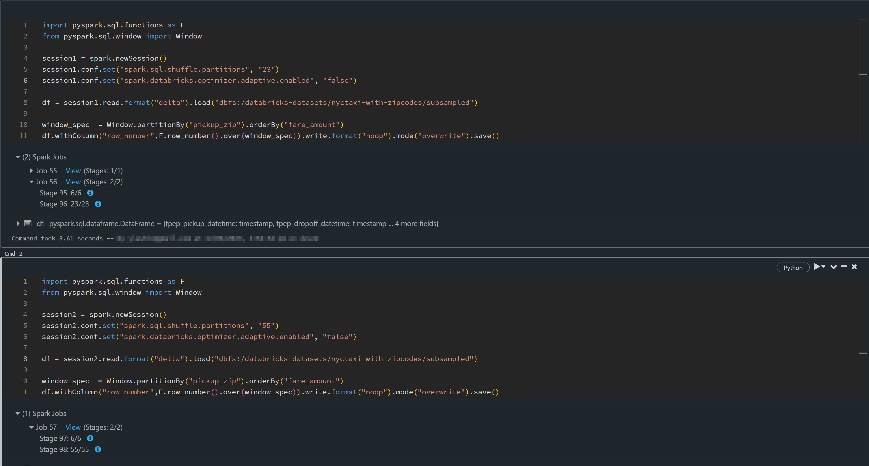
Isolated Spark Sessions

Slide 29

Wrap up
Contact : https://www.linkedin.com/in/yousrymohamed
Source code: https://github.com/ylashin/dataengbytes-bne-2023

